Slide 1



K. J. Somaiya Institute of Engineering & Information Technology, Mumbai
Department of Computer Engineering
Minor Project Presentation (Sem V)
Academic Year 2021-22
Newsletter Generator
Hiral Shah
Jai Shah
Sarvesh Soni
Supervisor
Prof. Nisha Vanjari

Slide 2

Outline of Project
Introduction
Problem statement
Project Objective
Proposed system / idea
Software and Hardware requirement
System design
System implementation
Conclusion
References

Slide 3
Introduction
Newsletter Generator is a Web based Application that will generate a newsletter for Computer Department.
It takes category-based inputs from all the faculty members that is to be submitted in the newsletter.
The admin can view and edit these submissions, and add content by themselves too.
The basic aim was to create a place where all the information to be uploaded in the newsletter is available at one place and newsletter can be created easily.

Slide 4
Problem Statement
Departmental Newsletter consists of different achievements, statistics, etc. related to both, students and teachers.
It becomes difficult for the faculty co-ordinate with others to collect this data for the newsletter.
Problem Statement:
Create a newsletter portal which collects information from all the faculty members and the admin and edit this content and generate a newsletter automatically according to the requirements.

Slide 5
Project Objective
The vision of this project is to create a web application where all the content for the newsletter is curated at one place for the Newsletter Coordinator to edit and generate a newsletter.
The main aim of the project is solving the problem where in the Newsletter Coordinator has to collect information individually from all faculty members and then create a newsletter.
Project Objective:
Collect all the information from the Faculties.
Admin should be able to view and edit the submissions.
Newsletter should be generated in click of a button.

Slide 6
Proposed System / Idea
Newsletter Generator Web Application has 2 different Logins. One for the faculties and one for the Admin. The faculties have to sign up on the website. After signing in, the faculties will have to submit information according to the categories provided. They can fill in the required details and submit the data. The admin can views these submissions and select whatever is required. Admin can also add information by themselves. After all additions and changes, the Admin can download the Newsletter.

Slide 7
Software and Hardware Requirement
HARDWARE REQUIREMENTS:
HARDWARE REQUIREMENTS FOR PROJECT:
PROCESSOR : Intel Pentium dual core or above.
RAM : 1 GB
STORAGE : 50 MB (FOR WEB BROWSER)
Network Interface.
SOFTWARE REQUIREMENTS:
SOFTWARE REQUIREMENTS FOR PROJECT:
OPERATING SYSTEM : Windows 7 or above, Ubuntu v12.04 or above.
FRONT END : HTML, CSS, JavaScript, Bootstrap, jQuery
SERVER SIDE SCRIPT : Django, Python
DATABASE: PostgreSQL

Slide 8
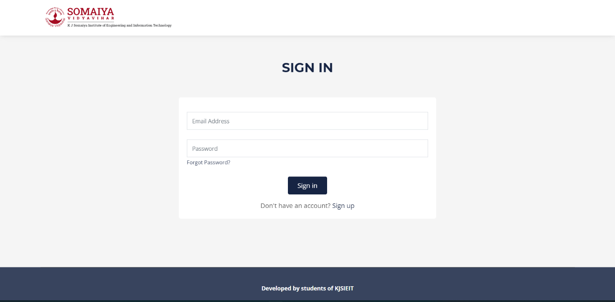
System Implementation:
Sign In Page

Slide 9
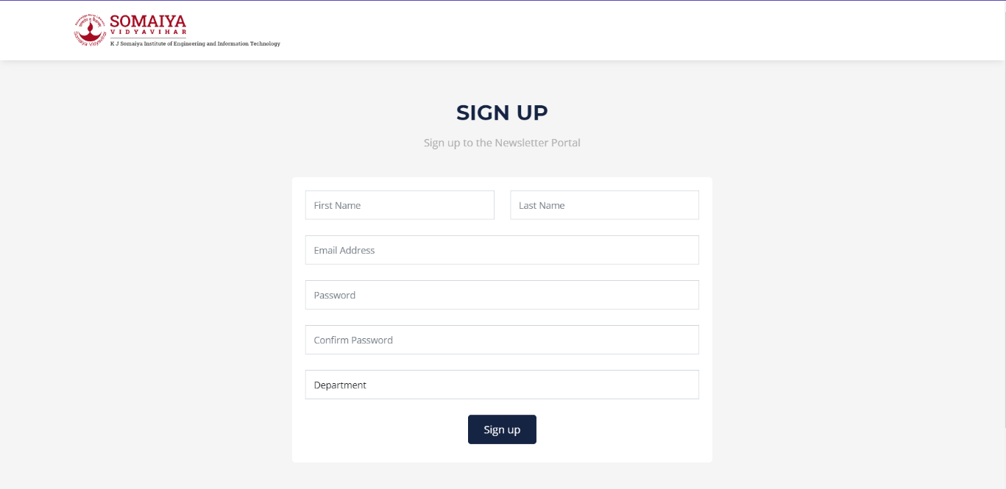
System Implementation
Sign Up Page

Slide 10
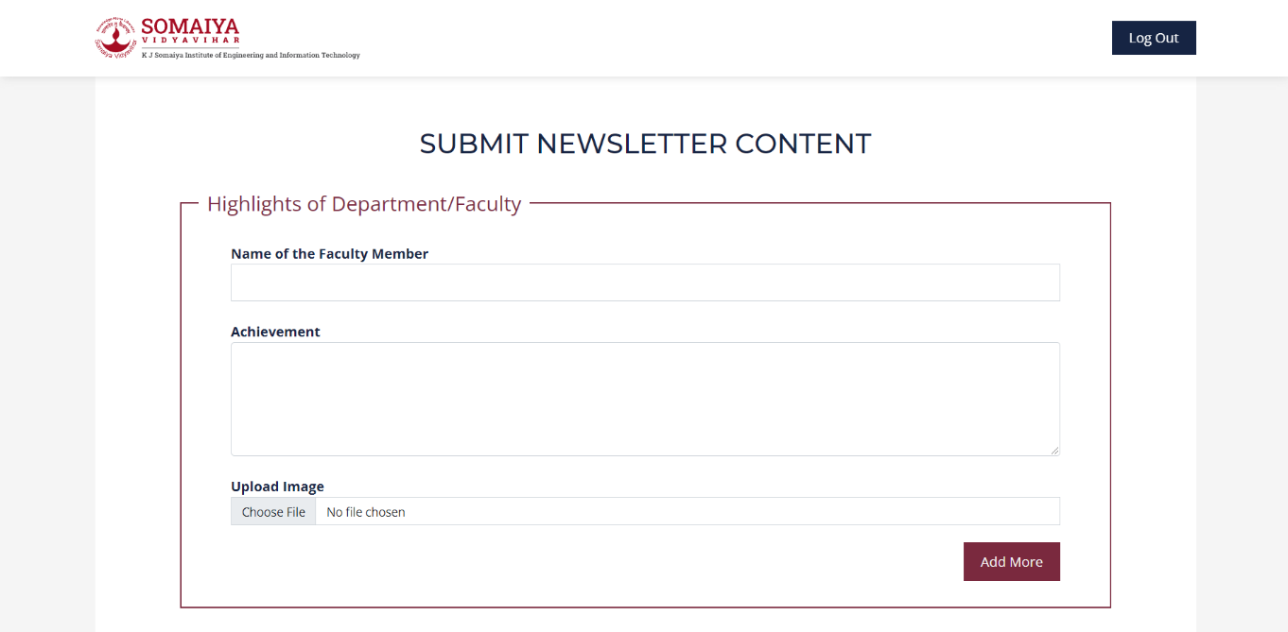
System Implementation
Submission Page for Faculty

Slide 11
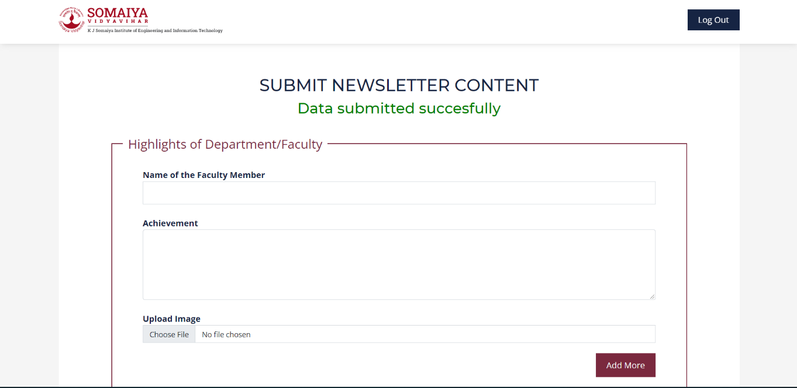
System Implementation
Data Submitted to the Database

Slide 12
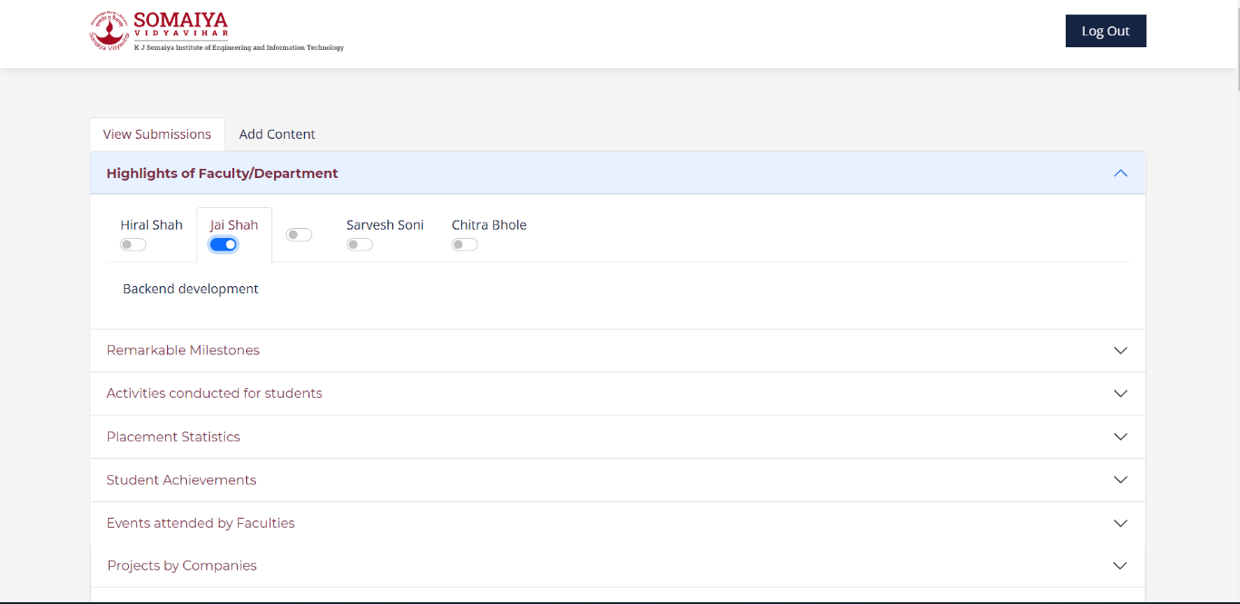
System Implementation
Admin Page

Slide 13
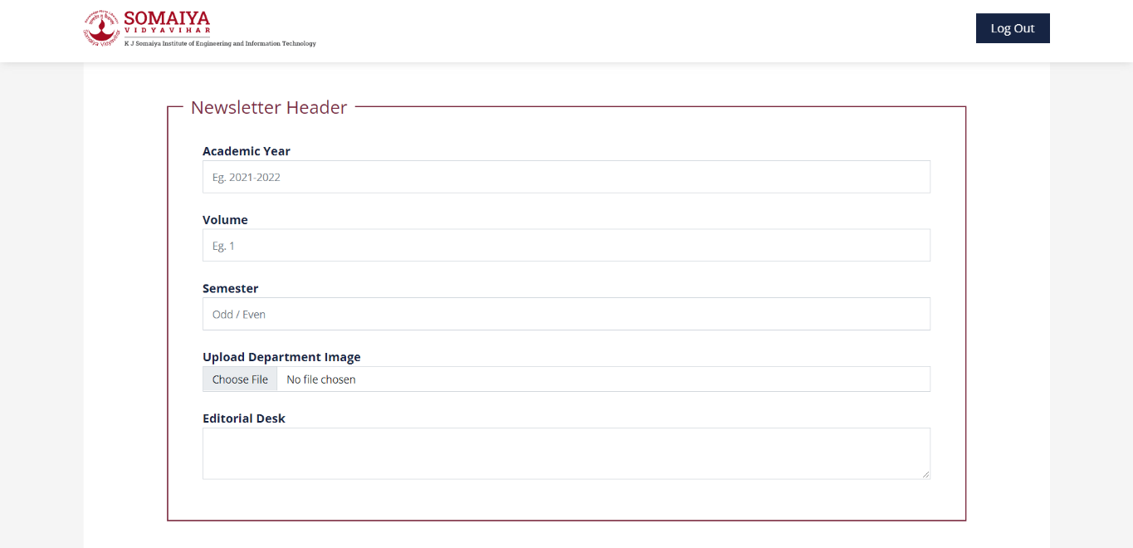
System Implementation
Information filling option for the Admin

Slide 14
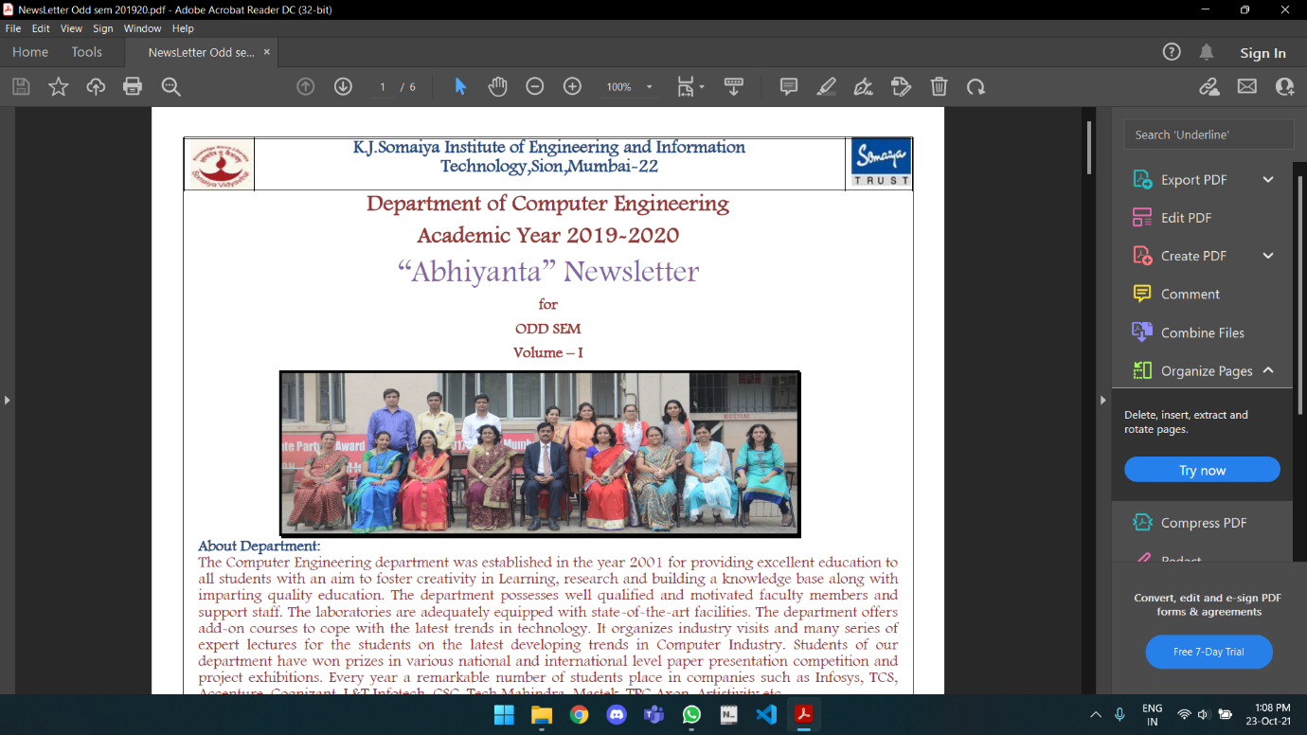
System Implementation
Resultant Output

Slide 15
References
We have referred the following websites:
Django Tutorials - https://www.youtube.com/watch?v=OTmQOjsl0eg&t=7483s
Django Documentation - https://docs.djangoproject.com/en/3.2/
jQuery Documentation - https://jqueryvalidation.org/documentation/
jsDelivr Documentation - https://www.jsdelivr.com/package/npm/documentation-theme-griest
Bootstrap Documentation - https://getbootstrap.com/docs/5.0/getting-started/introduction/
Python Documentation - https://docs.python.org/3.9/

Slide 16
Conclusion
We have made this project aiming to solve the difficulties faced during making the newsletter by the Admin.
The Project can be remolded and integrated into a various fields where such documents needed to be generated with user inputs.

Slide 17
Thank You

